Slide 1
Python Bootcamp
Session 3 : Tests, Loops and Custom Functions

Slide 2
If Test
if condition:
on fait quelque chose
elif condition:
on fait quelque chose
else:
on fait quelque chose

Slide 3
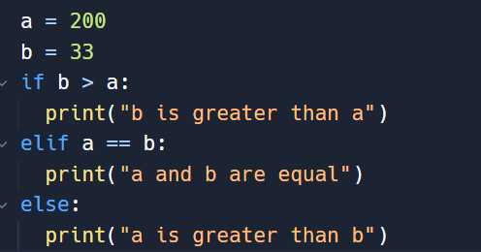
What will this test print out ?

Slide 4
For Loop
Used for iterating over a sequence (that is either a list, a tuple, a dictionary, a set, or a string)
Syntax:
fruits = ["apple", "banana", "cherry"]
a_dict = {'color': 'blue', 'fruit': 'apple', 'pet': 'dog'}
for x in fruits:
print(x)
for i in range(5):
print(i)
for key in a_dict:
print(key)

Slide 5
While Loop
The while loop will be executed as long as the condition is true
Syntax:
i = 1
while i < 6:
print(i)
i = i + 1

Slide 6
Break Statement
The break statement can stop any loop if a condition is true
Syntax:
i = 1
while i < 6:
print(i)
if i == 3:
break
i = i + 1

Slide 7
Custom Functions in Python
Use the def keyword to begin the function definition
Name your function and then follow it by brackets and colon “( ) : ”
Supply parameters in the brackets if needed
Enter lines of code on the line after to make your function do whatever you want
Use the return keyword at the end of the function to return the output. If omitted, the function will return None

Slide 8
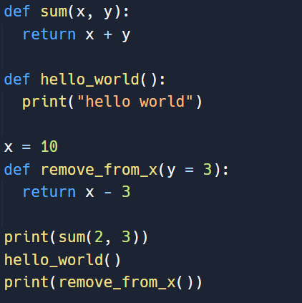
What will these functions print out ?
Notes:
def sum(x, y):
return x + y
def hello_world():
print("hello world")
x = 10
def remove_from_x(y = 3):
return x - 3
print(sum(2, 3))
hello_world()
print(remove_from_x())

Slide 9
Common Errors
Indentation matters ! Each code block should be indented with the same amount of indentations (“tab”)
Do not forget the “:” at the end of if, elif, else, def …. statement
Always check the type of variables you are using together. For example, you cannot sum lists with tuples etc.

